Slide 1
Chapter 1
The Systems Development Environment

Slide 2
Learning Objectives
Define information systems analysis and design.
Describe the information systems development life cycle (SDLC).
Explain Rapid Application Development (RAD) and
computer-aided software engineering (CASE) tools.
Describe Agile Methodologies and eXtreme Programming.
Explain object-oriented analysis and design and the Rational Unified Process (RUP).

Slide 3
Introduction
Information Systems Analysis and Design
Complex organizational process
Used to develop and maintain computer- based information systems
Used by a team of business and systems professionals

Slide 4
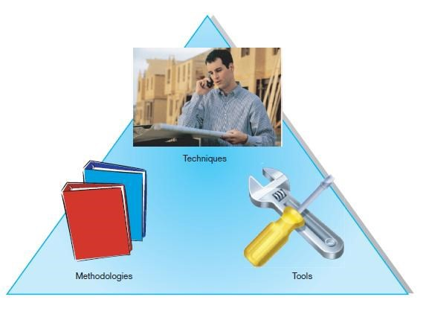
Introduction (Cont.)
FIGURE 1-1 An organizational approach to systems analysis and design is driven by methodologies, techniques, and tools

Slide 5
Introduction (Cont.)
Application Software
Computer software designed to support organizational functions or processes
Systems Analyst
Organizational role most responsible for analysis and design of information systems

Slide 6
A Modern Approach to Systems Analysis and Design
1950s: focus on efficient automation of existing processes
1960s: advent of procedural third generation languages (3GL) faster and more reliable computers
1970s: system development becomes more like an engineering discipline

Slide 7
A Modern Approach to Systems Analysis and Design (Cont.)
1980s: major breakthrough with 4GL, CASE tools, object-oriented methods
1990s: focus on system integration, GUI applications, client/server platforms, Internet
The new century: Web application development, wireless PDAs and smart phones, component-based applications, application service providers (ASP)

Slide 8
A Modern Approach to Systems Analysis and Design (Cont.)
Trends in System Development
✅ Internet & Networks – Focus on building systems for the Internet, intranets, and extranets.
✅ Three-Tier Architecture – Systems use:
- Database server
- Application server
- Client (user’s device)
✅ Wireless Technology – Web applications can be accessed from anywhere via wireless devices.
✅ Off-the-Shelf Solutions & Cloud – Many companies buy ready-made software or use cloud-based applications instead of developing in-house.

Slide 9
Developing Information Systems
System Development Methodology is a standard process followed in an organization to conduct all the steps necessary to analyze, design, implement, and maintain information systems.

Slide 10
Systems Development Life Cycle (SDLC)
Traditional methodology used to develop, maintain, and replace information systems
Phases in SDLC:
Planning
Analysis
Design
Implementation
Maintenance

Slide 11
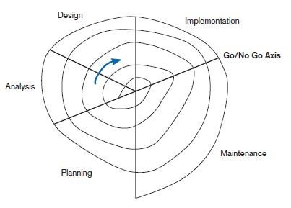
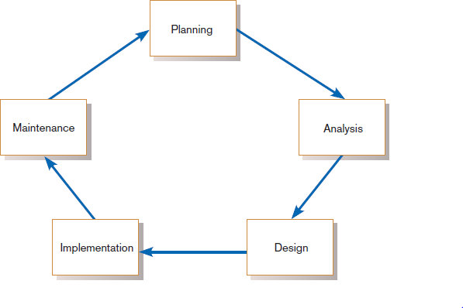
Standard and Evolutionary Views of SDLC
FIGURE 1-3 Evolutionary model
FIGURE 1-2
Systems development life cycle

Slide 12
Systems Development Life Cycle (SDLC) (Cont.)
Planning – an organization’s total information system needs are identified, analyzed, prioritized, and arranged
Analysis – system requirements are studied and structured
Design – a description of the recommended solution is converted into logical and then physical system specifications

Slide 13
Systems Development Life Cycle (SDLC) (Cont.)
Logical design – all functional features of the system chosen for development in analysis are described independently of any computer platform
Physical design – the logical specifications of the system from logical design are transformed into the technology-specific details from which all programming and system construction can be accomplished

Slide 14
Systems Development Life Cycle (SDLC) (Cont.)
Implementation – the information system is coded, tested, installed and supported in the organization
Maintenance – an information system is systematically repaired and improved

Slide 15
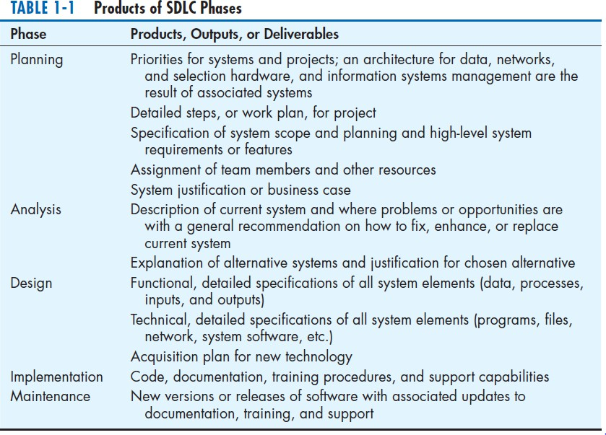

Slide 16
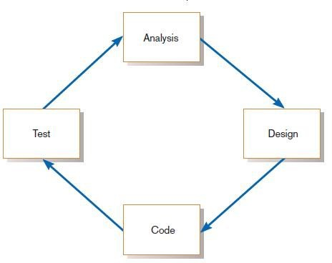
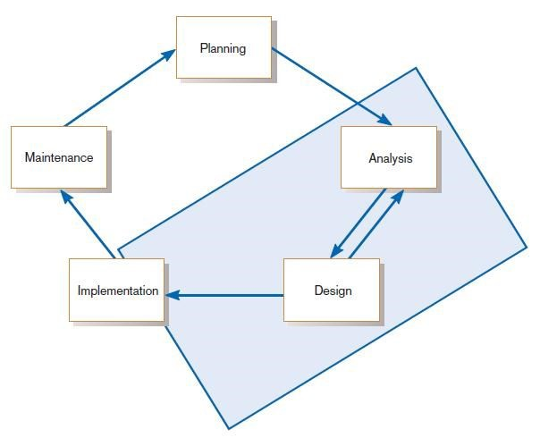
The Heart of the Systems Development Process
FIGURE 1-8
Analysis–design–code–test loop
FIGURE 1-9
The heart of systems development
Current practice combines analysis, design, and implementation into a single iterative and parallel process of activities.
Chapter 1
Copyright © 2014 Pearson Education, Inc. Publishing as Prentice Hall

Slide 17
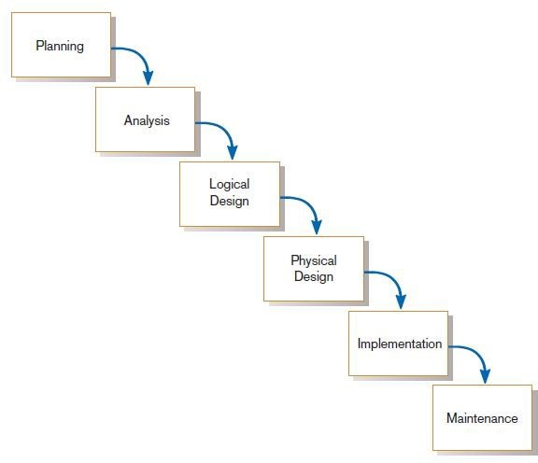
Traditional Waterfall SDLC
One phase begins when another completes, with little backtracking and looping.
FIGURE 1-10
Traditional waterfall SDLC

Slide 18
Problems with Waterfall Approach
Feedback ignored, milestones lock in design specs even when conditions change
Limited user involvement (only in requirements phase)
Too much focus on milestone deadlines of SDLC phases to the detriment of sound development practices

Slide 19
Different Approaches to Improving Development
CASE Tools
Rapid Application Development (RAD)
Agile Methodologies
eXtreme Programming

Slide 20
Computer-Aided Software Engineering (CASE) Tools
Diagramming tools enable graphical representation.
Computer displays and report generators help prototype how systems “look and feel”.
IBM’s Rational products are the best known CASE tools.

Slide 21
Computer-Aided Software Engineering (CASE) Tools (Cont.)
Analysis tools automatically check for consistency in diagrams, forms, and reports.
A central repository provides integrated storage of diagrams, reports, and project management specifications.

Slide 22
Computer-Aided Software Engineering (CASE) Tools (Cont.)
Documentation generators standardize technical and user documentation.
Code generators enable automatic generation of programs and database code directly from design documents, diagrams, forms, and reports.

Slide 23
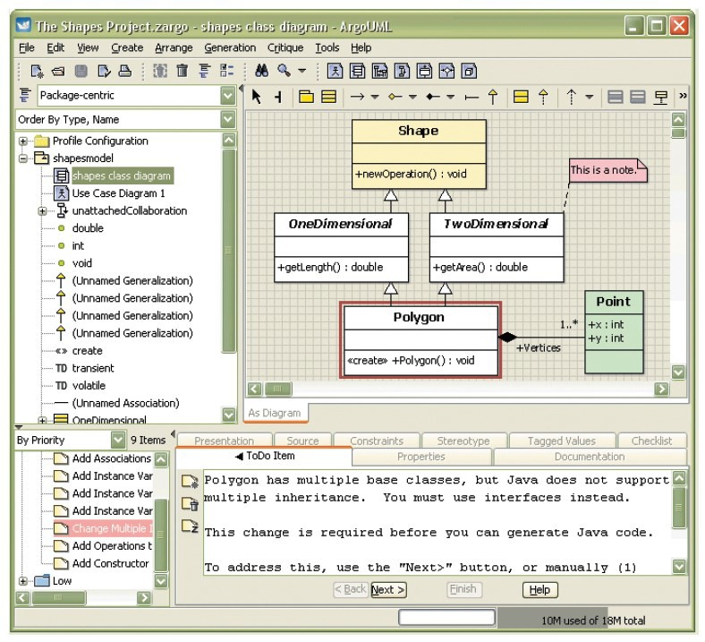
CASE Tools (Cont.)
FIGURE 1-11
Screen shot of ArgoUML, an open source CASE tool
(Source: http://argouml.tigris.org/)

Slide 24
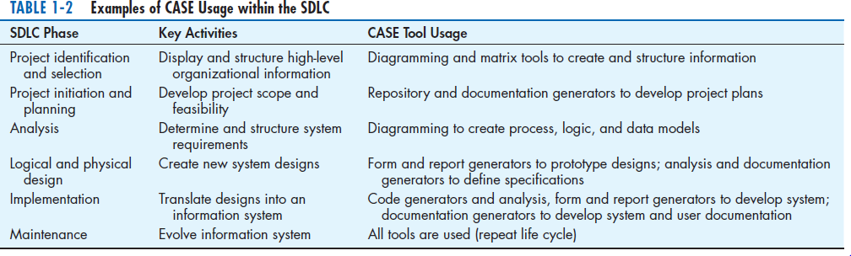
CASE Tools (Cont.)

Slide 25
Rapid Application Development (RAD)
Decreases design and implementation time
Involves: extensive user involvement, prototyping, integrated CASE tools, code generators
More focus on user interface and system function, less on detailed business analysis and system performance

Slide 26
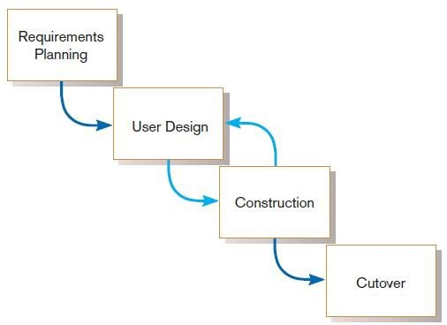
Rapid Application Development (RAD) (Cont.)
FIGURE 1-12
RAD life cycle

Slide 27
Agile Methodologies
Motivated by recognition of software development as fluid, unpredictable, and dynamic
Three key principles
Adaptive rather than predictive
Emphasize people rather than roles
Self-adaptive processes

Slide 28
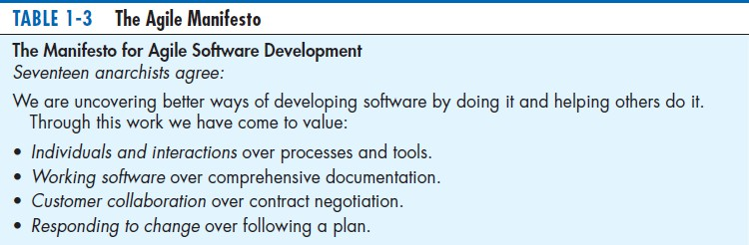
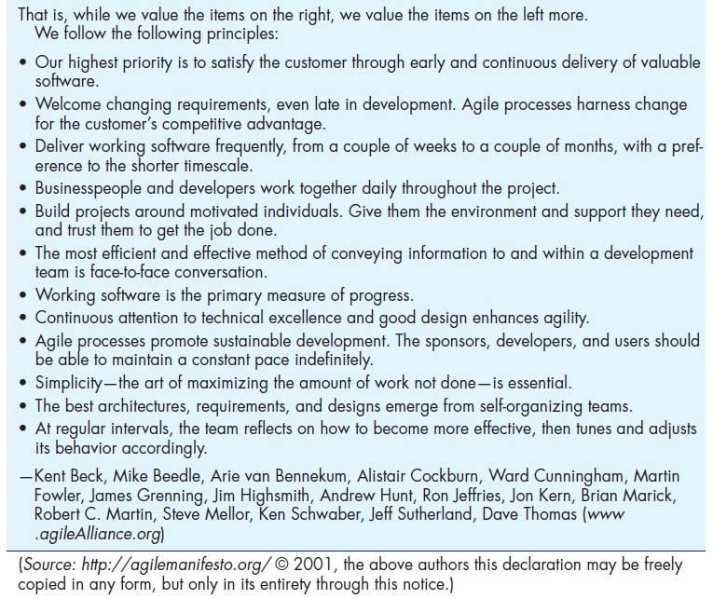
The Agile Methodologies group argues that software development methodologies adapted from engineering generally do not fit with real- world software development.

Slide 29
When to use Agile Methodologies
If your project involves:
Unpredictable or dynamic requirements
Responsible and motivated developers
Customers who understand the process and will get involved

Slide 30
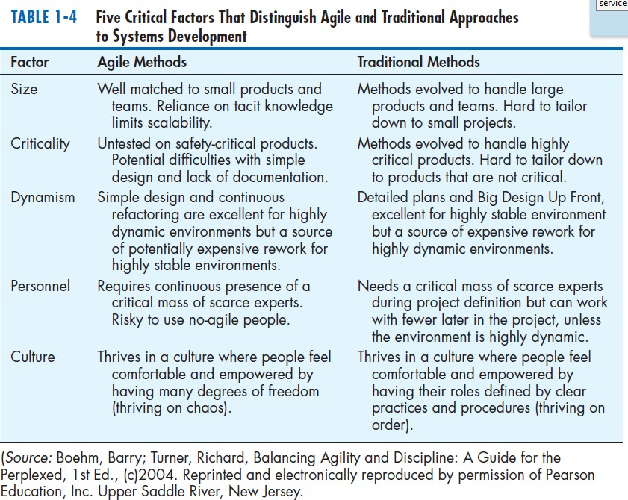

Slide 31
eXtreme Programming
Short, incremental development cycles
Automated tests
Two-person programming teams
Coding, testing, listening, designing

Slide 32
eXtreme Programming (Cont.)
Coding and testing operate together
Advantages:
Communication between developers
High level of productivity
High-quality code

Slide 33
Object-Oriented Analysis and Design (OOAD)
Based on objects rather than data or processes
Object: a structure encapsulating attributes and behaviors of a real- world entity

Slide 34
Object-Oriented Analysis and Design (OOAD) (Cont.)
Object class: a logical grouping of objects sharing the same attributes and behaviors
Inheritance: hierarchical arrangement of classes enable subclasses to inherit properties of superclasses

Slide 35
Rational Unified Process (RUP)
An object-oriented systems development methodology
Establishes four phase of development: inception, elaboration, construction, and transition
◻ Each phase is organized into a number of separate iterations.

Slide 36
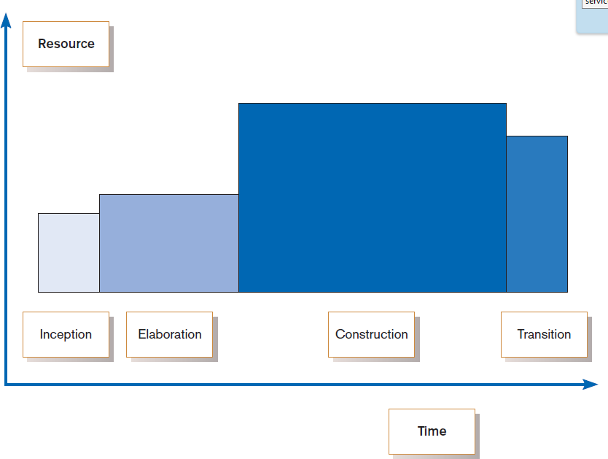
FIGURE 1-13
Phases of OOSAD-based development

Slide 37
Our Approach to Systems Development
The SDLC is an organizing and guiding principle in this book.
We may construct artificial boundaries or artificially separate activities and processes for learning purposes.
Our intent is to help you understand all the pieces and how to assemble them.

Slide 38
Summary
In this chapter you learned how to:
Define information systems analysis and design.
Describe the information Systems Development Life Cycle (SDLC).
Explain Rapid Application Development (RAD), prototyping, Computer Aided Software Engineering (CASE), and Service-Oriented Architecture (SOA).
Describe agile methodologies and eXtreme programming.
Explain Object-Oriented Analysis and Design (OOAD) and the Rational Unified Process (RUP).

